Slide 1


Slide 2
Unit I: Fundamentals of Entrepreneurship
Fundamentals of Entrepreneurship – Characteristics of Entrepreneurs –Myths of Entrepreneurship -Role of Entrepreneurs in Indian economy – Social and Ethical Perspectives of Entrepreneurship.

Slide 3
Introduction
The word „entrepreneur ‟is derived from the French verb „enterprendre . ‟It means “to undertake”. Around 1700 A.D. the term was used for architects and contractor of public works.
In many countries, the term entrepreneur is often associated with a person who starts his own new business. Business encompasses manufacturing, transport, trade and all other self employed vocation in the service sector.
Entrepreneurship has been considered as the tendency of mind to take calculated risk with confidence to achieve predetermined business objectives.

Slide 4
HISTORY OF ENTREPRENEURSHIP IN INDIA
The Indian trade and business was at its peak. Indians were experts in melting of metals such as brass and tin.
Kanishka Empire in the 1st century started nurturing Indian entrepreneurs and traders. Following that period, in around 1600 A.D.
India established its trade relationship with Roman Empire. Gold was pouring from all sides. Then came the Portuguese and the English. They captured the Indian sea waters and slowly entered the Indian business.

Slide 5
Definition
Entrepreneur as a dynamic agent of change, a Catalyst who transforms increasingly physical, natural and human resources into corresponding production Possibilities.- Schumpeter
“An individual who bears the risk of operating a business in the face of uncertainty about the future conditions -Encyclopedia of Britannica
“Entrepreneurs take initiative, accept risk of failure and have an internal focus of control.”- Albert Shapero

Slide 6
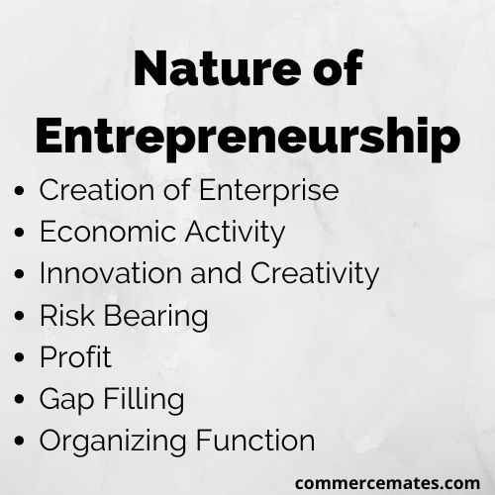

Slide 7


Characteristics of Entrepreneur
Commitment, Determination and Perseverance
Drive to achieve
Opportunity orientation
Initiative and Responsibility
Persistent problem Solving
Seeking feed Back
Internal Control
Tolerance for ambiguity

Slide 8



Characteristics of Entrepreneur
Calculated Risk taking
Integrity and reliability
Tolerance for failure
High Energy Levels
Creative and Innovativeness
Vision
Self Confidence and Optimism
Independence
Team Building

Slide 9
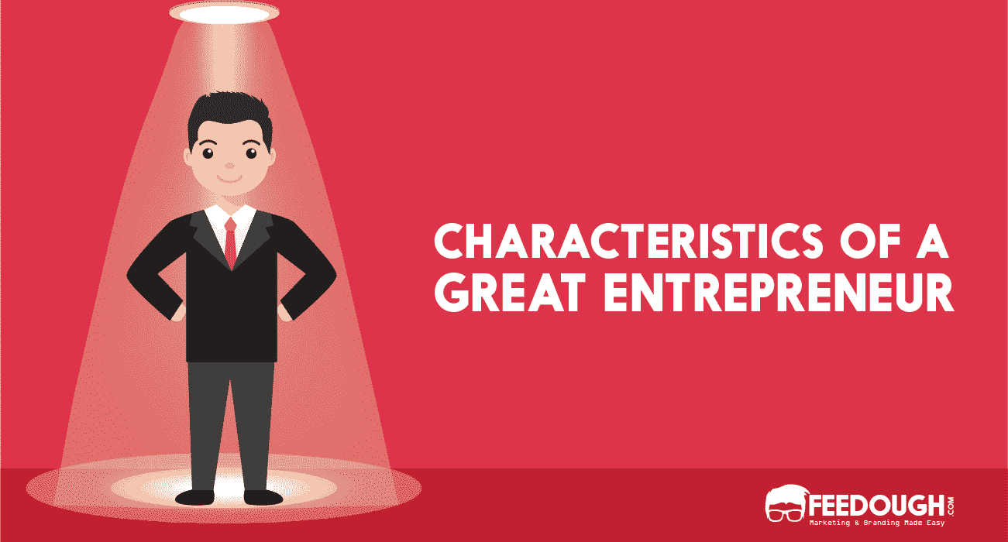
Characteristics of Entrepreneur
UNIT-I

Slide 10
10 Common Worries and How to Overcome
1. I am not bright enough: Well, sometimes you can be too bright to succeed. Innocence and inexperience can actually protect you from fear. It is possible to think too much!
2. I am not pushy enough: Do you like doing business with pushy people or do you prefer nice reasonable people? Pushy people are often less successful than you might think.
3. I am not rich enough: One of the best ways to watch your costs is to have no money to waste. Wealthy people can be careless with money—you probably cannot afford to be.
4. I am not good at sums: Relax, spreadsheets and accounting software make the numbers easy to work out. Remember that success is as much about instinct as arithmetic.
5. I cannot spell: Literacy is great if you want to write books but less important if your business communicates with customers verbally. Use document templates—there are some at the back of this book.

Slide 11
10 Common Worries and How to Overcome
6. I will fail: Maybe you will, but equally you will not make your first million if you do not try.
7. Rivals will eat me alive: In fact, the opposite is usually the case. Young, small businesses can duck and weave beneath the fists of those nasty big competitors.
8. I am naturally pessimistic: So, you will not make false assumptions and step into the dark without a torch, will you? A glance at the downside puts the upside in perspective—just be sure to see both.
9. I do not take risks: Running a business is like crossing the road. You can jaywalk, wear dark clothing and risk getting squashed—or push the button and follow the green man when the traffic stops. There is almost always a choice.
10. I know my failings: We all know what we are bad at and we all underestimate the value of our strengths. No one is perfect nor is any business. That is why there is room for you too. Focus on what you do well.

Slide 12
The Myths of Entrepreneurship
Entrepreneurs are Born, Not Made
Entrepreneurs are doers, Not Thinkers
Entrepreneurs always Inventors
Entrepreneurs are Academicians
Entrepreneurs must fit the profile
All Entrepreneurs need is Money
All Entrepreneurs need is Luck
Most Entrepreneurs initiatives fail
Entrepreneurs are extreme risk takers and Gamblers

Slide 13
Entrepreneurs are Born, Not Made
The Idea that the characteristics of entrepreneurs can not be taught or learned.
They are internal traits one must be born with aggressiveness, initiative, a willingness to take risks, analytical ability and skill in human relations.
Entrepreneurship is a discipline.
Entrepreneurship can be taught and developed through class room.

Slide 14
Entrepreneurs are doers, Not Thinkers
Thinking Entrepreneurs are important as doing Entrepreneurs.
All visionaries starts as thinkers and dreamers.
Most Entrepreneurs start with thing about doing something new.

Slide 15

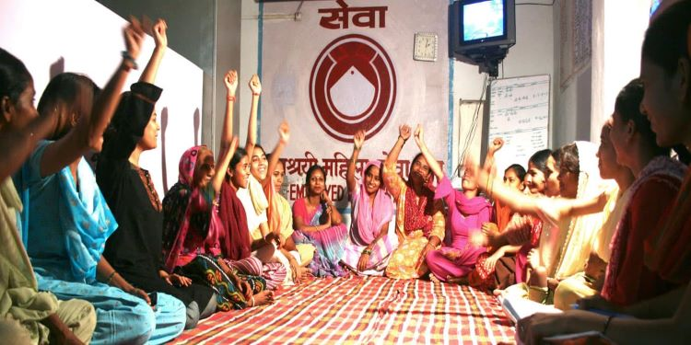

Entrepreneurs always Inventors
It is more than just invention.
Ideas are also became enterprises.
Ex:

Slide 16


Entrepreneurs are Academicians
The belief that entrepreneurs are academically and socially effective is a result of some business owners.
Entrepreneurs are professional role models.
Ex: Infosys, L&T, Kingfisher airlines

Slide 17
Entrepreneurs must fit the profile
In India Entrepreneurs showing different profiles like business, social, educational.

Slide 18


All Entrepreneurs need is Money
Many successful Entrepreneurs have a lack of money while establishing their ventures.
Failures due to lack of proper financing, poor investment, poor planning

Slide 19

All Entrepreneurs need is Luck
The right place at right time – always an advantage
Luck happens when preparation meets opportunity
Luck will arrive when actually preparation, determination, desire, knowledge, innovativeness.

Slide 20

Entrepreneurs always innovators
Many Entrepreneurs do suffer a number of failures before they are success
First you don’t succeed but try and try and again.
In 1993 Kirchhoff traced 8,14,000 businesses started in 1977 and founded that more than 50 percent were still serving.

Slide 21
Entrepreneurs are extreme risk takers and Gamblers
Most successful entrepreneurs work hard through planning and preparation to minimize risk.
They are not gamblers hard workers

Slide 22
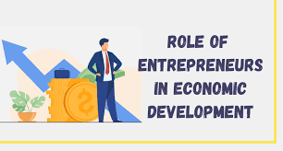

Slide 23
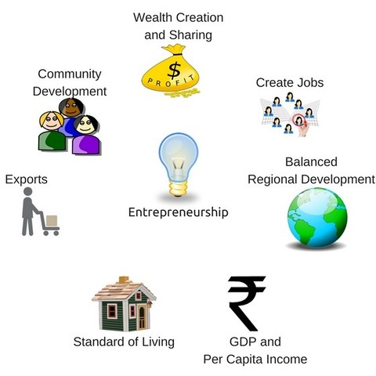

Slide 24
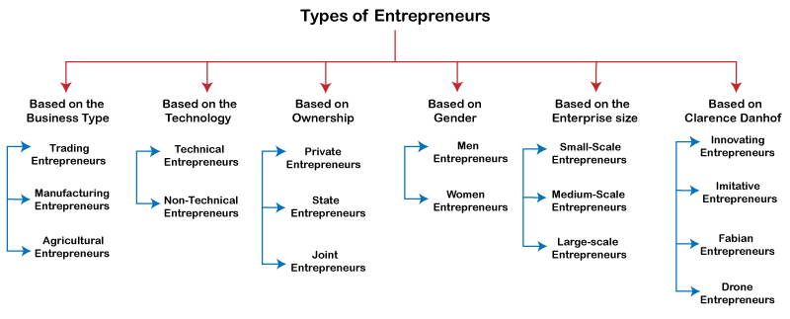

Slide 25
1. Entrepreneurs can help increase employment:
Entrepreneurs are expected to provide employment opportunities to the unemployed.
The rural entrepreneurs and women entrepreneurs can play a very significant role.

Slide 26

2.Entrepreneurial initiatives can contribute to higher gross national product and per capita income:
Entrepreneurial initiatives and activities can enhance the level of gross national product as well as per capita income of the people in a country leading to the economic development of the economy.

Slide 27
3. Entrepreneurs can contribute towards capital formation:
The gross capital formation in India for the year of $3.25 trillion nominal; 2022.
Indian entrepreneurs can promote capital formation in the economy. Entrepreneurs can increase the avenues for fruitful investments.
At present India is expected to reach GDP level 1850.00 USD by the end of 2022, (1920.00 USD by 2023)

Slide 28
4. Entrepreneurial activities can significantly influence the standard of living:
According to the Human Development Index of 2020, India is ranked at 131 th position among 188 countries. Entrepreneurs can play a vital role in enhancing the standard of living of the people by adopting latest innovations in the production of wide variety of goods and services. They can make available the best quality products and services in possible cheapest cost.

Slide 29
5. Entrepreneurs endeavour to promote balanced regional development:
The growth of industries and business in backward areas would lead to a large number of benefits for the public like road transport, health, education, etc. The entrepreneurs can contribute to balanced regional development.
The Corporate Social Responsibilities (CSR) of the established entrepreneurs can improve the backward regions. The CSR activities have been made mandatory for the companies that come under the categories recognized under Companies Act of 2013.

Slide 30
6. Entrepreneurial activities would lead to wealth creation and distribution:
Entrepreneurial activities guided by national interest would lead to generation of greater wealth as well as its distribution.

Slide 31
7. Entrepreneurial initiatives can help in skill development:
The Indian entrepreneurs can play a vital role in skill development and thereby contribute to the process of job creation and development of the economy. The entrepreneurs should take the initiative of improving the skill of the semi­skilled or unskilled labour force.

Slide 32

8. Entrepreneurs can improve India’s global competitiveness:
In the India maintains 43rd rank on IMD’s(Indian Meteorological Department/1875) World Competitiveness Index, published by World Economic Forum. The entrepreneurial class has to take up the challenge and contribute towards improving the competiveness of Indian economy.

Slide 33
9. Entrepreneurs can increase the country’s share in global export trade:
India’s share in Global Merchandise exports is very low. The entrepreneurs have to track the avenues for export and concentrate to improve the share of Indian economy in global export trade.

Slide 34
10. Entrepreneurs ensure overall development of an economy:
The activities of the entrepreneurs can influence all the sections of the economy. They can reduce the negativity and pessimism of a society. Their activities generate enthusiasm among the followers.
A new level of development is dreamt by the entire economy and the Indian entrepreneurial class can contribute a lot in ensuring overall development of the country.

Slide 35
Social and Ethical Perspectives of Entrepreneurship

Slide 36
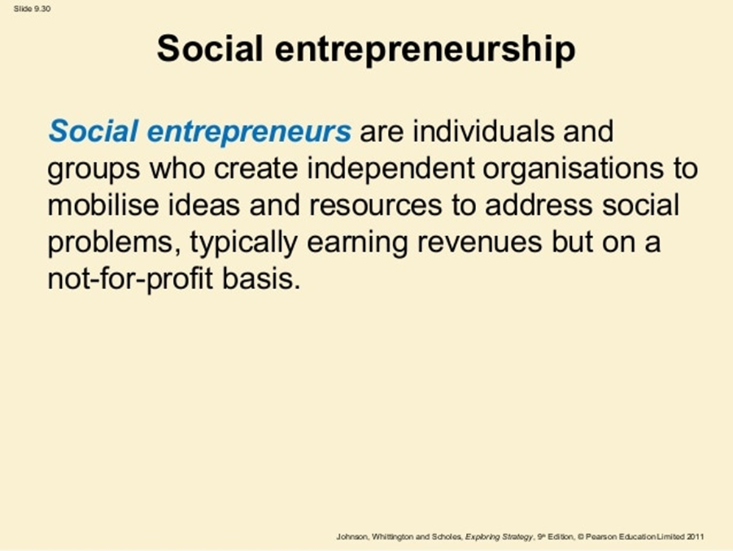

Slide 37
Introduction
Business entrepreneurs who are generally motivated by profit earnings, social entrepreneurs are motivated to improve the social wellbeing.
Social entrepreneurs also known as Public entrepreneurs or Civic entrepreneurs or social innovators.
India is much need of this new breed of Sociopreneurs to come out with unconventional business models to address the environmental and social issues.

Slide 38


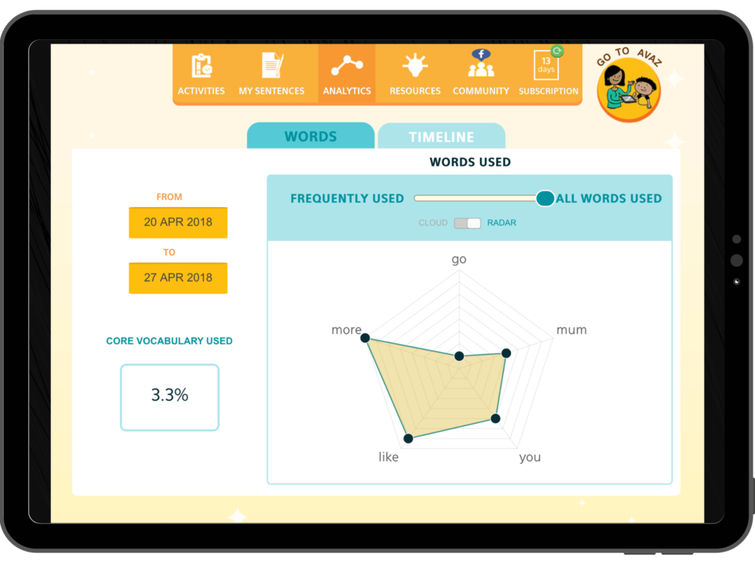
Avaz is India's first assistive device or people with speech disability. It empowers people to communicate their thoughts, emotions, ideas, needs and wants.
AVAZ was started in 2008 as a joint project of invention labs and IIT Madras M

Slide 39
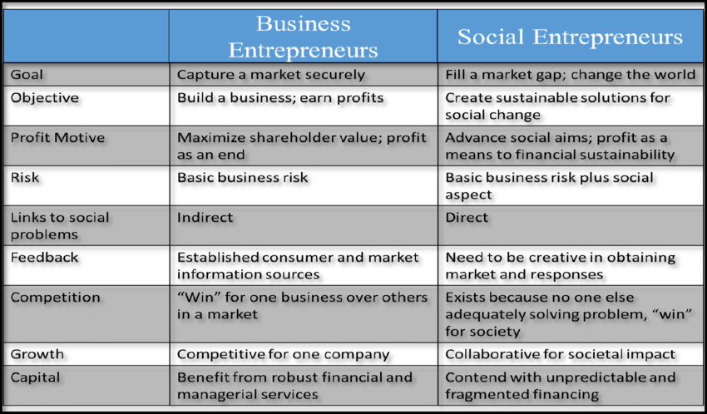

Slide 40
The four pillars of social enterprises
The economic viability of the project
Social and environmental objectives
Profit distribution
Governance

Slide 41
The economic viability of the project
Like any sustainable business activity, social entrepreneurship projects must meet a real demand previously identified in a market study. It needs to be profitable enough to create wealth and jobs.

Slide 42
Social and environmental objectives
Social or environmental goals are key to these types of project as they create the “social value” and the purpose of the business for both the team and the community.
These objectives mostly focused on improving the world, can be of different natures: from the access to health services and energy savings to reducing unemployment or encouraging local food consumption.

Slide 43
Profit distribution
Depending on the legal status of the company, profits can be reinvested primarily for the optimal achievement of social and environmental objectives. Individual profits are formally limited and rigorously supervised.

Slide 44
Governance
“Participation” is the key word of governance in social entrepreneurship. The collective interests always outcomes individual interests, decision-making is always a shared process. This means all stakeholders are involved: from managers and staff to customers/users, local or even the national political power.

Slide 45
Social entrepreneurs are characterized by the following key attributes:
(a) Ambitious
(b) Missionaries
(c) Strategic
(d) Resourceful
(e) Result Oriented

Slide 46
Ambitious
Having high ambition is one of the major characteristics of the social entrepreneurs. They are the reformers and revolutionaries with a social mission.
They are the ambitious people tackling major social issues and offering new ideas and solutions for wide-scale change.
Entrepreneurs are found in all walks of life and all kinds of organizations: innovative non­profits, social purpose ventures.

Slide 47

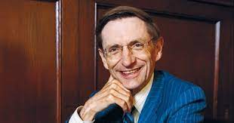
Missionaries:
The life-histories of successful social entrepreneurs reveal that their mission, i.e. the ultimate purpose is not creating just wealth, but most importantly, generating as much as possible social value. Wealth creation may be the part of effort, but is not an end in itself.
The view of Bill Drayton, CEO and founder of Ashoka, a global non-profit organization seem worth quoting. “Social entrepreneurs are not content just to give a fish or teach how to fish. They will not rest until they have revolutionized the fishing industry.”

Slide 48
Strategic:
Like the successful business entrepreneurs, social entrepreneurs also search and identify the major social issues what others miss. They use these as opportunities to improve the existing social systems, create solutions, and invent new approaches that create social value.

Slide 49
Resourceful:
Social entrepreneurs function in a social framework, not within the business world. They have limited resources because of their limited access to capital and traditional market support systems.
They need to be skilled enough to muster and mobilize human, financial, and political resources required to solve the social problems

Slide 50
Result Oriented:
Social entrepreneurs are driven to produce measurable results to make perceptible dent on the society. These results change even transform the existing equilibriums, realities, and create new pathways for the benefits of the people of the society.
They have the skill to unlock and harness the potential society has to effect social change.

Slide 51
Social Entrepreneurs in India
URVASHI SAHNI
Talking about the best of social entrepreneurs in India, Urvashi Sahni definitely tops the list. She is the founder and CEO of SHEF (Study Hall Education Foundation), an organization dedicated to offering education to the most disadvantaged girls in India.
Urvashi Sahni has worked with over 900 schools and changed the life of 150,000 girls (directly) and 270,000 girls (indirectly) with her program. She was rightly felicitated with the ‘Social Entrepreneur Of The Year‘ award in 2017 for her selfless act of dedication and passion.

Slide 52


Slide 53

HARISH HANDE
Harish Hande is another pioneering social entrepreneur of India and a remarkable committed one. He is the CEO & Founder of Selco, a company rendering sustainable energy source to rural regions of the country.
This project was the first rural solar financing program in India. Till date, Selco has contributed over 120,000 installations and has more than 25 operating retail and service centres in Karnataka alone.

Slide 54
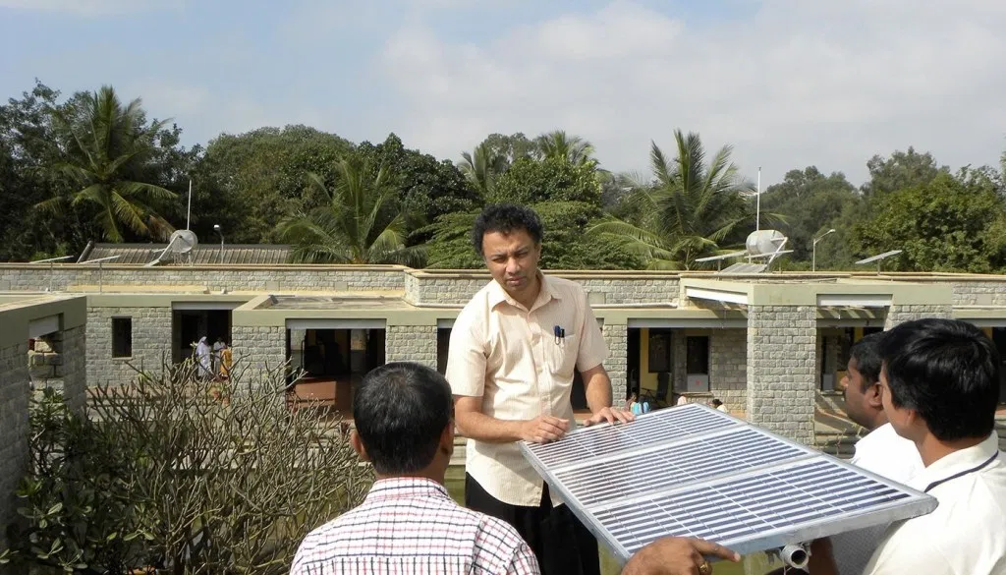

Slide 55
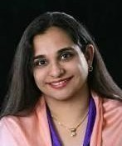

JEROO BILLMORIA
Jeroo Billmoria is one of the renowned social entrepreneurs of India who is supervising several International NGOs for the betterment of society.
She initiated the ‘Childline’ that aims to provide help in form of healthcare and police assistance, especially to street children.
Right from her childhood, she had a vision of giving back to the underprivileged in the society. She also believed in self-empowerment of women in India.

Slide 56

Ethical Perspectives of Entrepreneurship

Slide 57
Introduction
It is Derived from the Greek word ethos, meaning custom or mode of conduct, ethics has challenged philosophers for centuries to determine what exactly represents right or wrong conduct.
Ethics is defined as a moral philosophy or code of morals practiced by a person or group of people.
Ethical conduct comes down to values. Some suggested values for ethical conduct of entrepreneurial endeavors: respect, honor, integrity, customer focus, results-orientation, risk-taking, passion, and persistence.

Slide 58
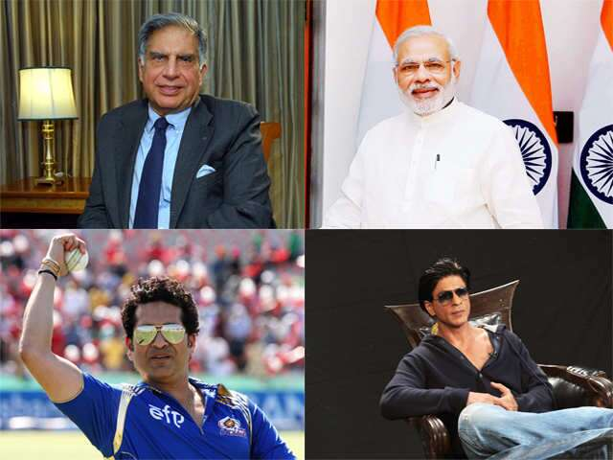
MOST ADMIRED PEPOLE IN INDIA

Slide 59
Examples:
• Tour operators bring the tourists to certain shops where the salespeople charge higher prices than other shops and later the profi ts are shared between the operators and the shop owners.
• Tobacco companies based in Britain and the US are largely responsible for the spread of the smoking habit to developing countries. Advertisements for Marlboro cigarettes show young, athletic, outdoorsy men and women, yet cigarettes kill millions each year.

Slide 60
Examples:
• Harry Potter sells Coca-Cola to kids.
• Coke and other sodas are filled with empty calories that are making kids fatter and put them at risk of serious diseases, not to mention dental cavities.
• Nestlé promotes infant formula as a substitute for breast milk around the world.

Slide 61
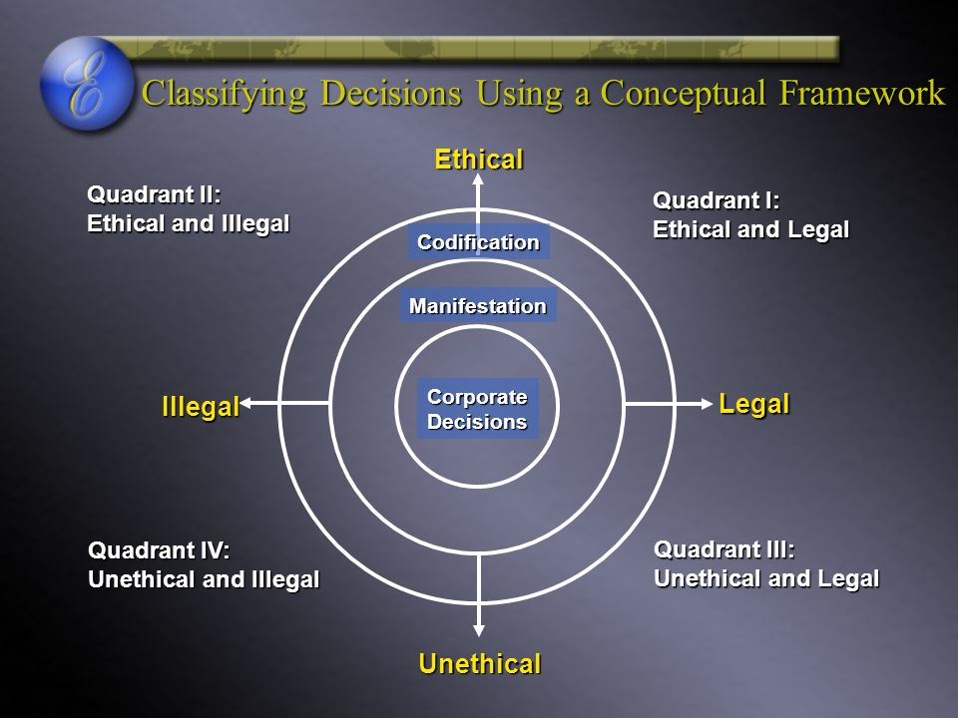

Slide 62


Characteristics of Ethical
Entrepreneur
Respect:
As an entrepreneur building a business, you need to respect yourself and surround yourself with people you can respect.
While you can assume your people will do their job as well as they can, they do need coaching, training and direction, but respect and trust make it easier for you to avoid micro-managing them.

Slide 63
Honor:
Good people are a fundamental part of good ethics. They are also great ambassadors for doing things right. Give special attention to strong performers and people who exemplify the spirit of your organization.
Most companies recognize top achievers and producers. Go beyond quotas and sales figures. These are people who have helped you be successful, and you need to acknowledge and honor their contributions publicly, as well as privately.

Slide 64
Integrity:
It is impossible to avoid sounding preachy or parental. Do not lie, steal, or cheat. Make your word your bond and always stand by your word.
When you are wrong, own up to it and make good on the deal. Treat others as you’d want to be treated.

Slide 65

Customer focus:
A company is nothing if it does not have customers. More to the point, if a company does not produce what people want and will pay for, there is no point to that company. A focus on your customers reinforces the responsibility you have to the market.
Selling your customers short not only risks compromising your ethics, it also risks the long-term health of your company.

Slide 66

Results-oriented:
You wouldn’t be an entrepreneur if you weren’t focused on results already, but ethics factor into results too. Don’t aim for results at any cost. Work on achieving your results within your company values.
Results should be attained in the context of developing something that customers want, and producing and delivering it at a price that is fair to all the parties involved.

Slide 67

Risk-taking:
Great companies innovate, they think “out of the box”, and they try new things. They re-invent themselves and they reward the risk-takers. As long as you stick to your philosophical guns, risk-taking poses no threat to your ethics.

Slide 68
Passion:
Great organizations are comprised of people who have a passion for what they are doing. These are people who are working for you for the thrill and challenge, not merely putting in time to collect a pay-check. They are excited, driven, and believe that their work and efforts can make a difference.

Slide 69
Persistence:
People in awesome organizations have the will to persist. They will keep working even when results are not what they hoped, or when customers refuse to buy.
They work harder, They continue to take risks. They behave with honor and integrity. They keep their focus on the customer’s needs and wants. And, they are not satisfied until they achieve the goals and results that are expected.

Slide 70
Best practices of these start-ups reveals several key steps new ventures
Ethical start-ups recognize the ethical dilemmas.
Ethical start-ups make ethics a core value of the enterprise.
ethical entrepreneur finds early opportunities.
ethical entrepreneur anticipates the ethical tensions in day-to-day decisions
The ethical entrepreneur welcomes ethical questions and debates
The ethical entrepreneur is watchful about conflicts of interest.

Slide 71
Best practices of these start-ups reveals several key steps new ventures
The ethical entrepreneur talks about the ethical values all the time.
The ethical entrepreneur weeds out employees who do not embrace the ethical values of the company
he ethical entrepreneur takes stock occasionally.
The ethical entrepreneur renews the commitment to ethical behavior.

